Slide 1
Data Structures Using C Course Code: CSIT124 B. Tech. (CSE) Module 1 Dr. Sheenu Rizvi Asst. Professor

Slide 2
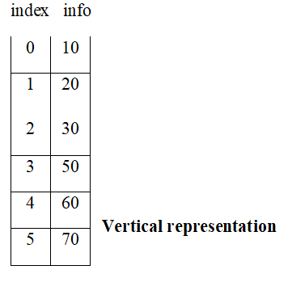
Array
An array is a group of related data item that share a common name or collection of similar entity stored in contiguous memory location. Each of elements of an array share a variable but each element having different index no. known as subscript. An array can be a single dimensional or multi-dimensional and number of subscripts determines its dimension.
Ex. Array contains day of week, month of year, list of valid employee number, list of employee or student name.

Slide 3
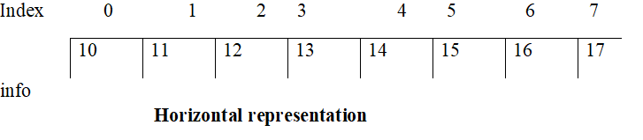

Slide 4
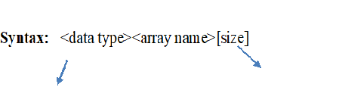
DECLARATION OF AN ARRAY :
int, float, double, char Maximum number of element it can store
Ex. int marks [30];
The quantity written in bracket [] to select particular value is called a subscript or an index.
The first element of an array has subscript [0].
The maximum range is 0 to 29.

Slide 5
Before using an array, its data types and dimension must be declared.
However big an array its elements are always stored in contiguous location.
Ex. The length of an array can be evaluated as
length =upper limit – lower limit + 1
that is length=UL- LL+1
for an array abc [100] the length of the array can be evaluated as
UL=99
LL=0
Length=99-0 +1
=100
That is abc will store maximum of 100 elements only.

Slide 6
ACCESSING OF ARRAY ELEMENT:
// WAP to ask user enter age of 10 student and display them.
#include<stdio.h>
void main()
{
int i, array[10];
for(i=0;i<10;i++)
{
array[i]=0;
}
printf("enter age for student");
for(i=0;i<10;i++)
{scanf("%d",&array[i]);
}

Slide 7
printf("the age of student is");
for(i=0;i<10;i++)
{
printf("the age of %d student is %d \n ",i, array[i]);
} }
INITIALIZATION OF AN ARRAY:
If specific value is not given in array, they are supposed to contain garbage value, if the array is initialized where it is declared mentioning the dimension of array is optional. We initialize array at the time of declaration its storage class must be static or extern.
static int temp [5] = {10,20,30,40,50};
static int temp [] = {1,2,3,4};

Slide 8
Syntax:
static<data type><array name>[size]={list of value};
Q Program to declare an array using static storage class and display the contents.
#include<stdio.h>
void main ()
{
static int array[8]={10,20,30,40,50,60,70,80};
int i;
for(i=0;i<8;i++)
{
printf (“%d %d”, i, array[i]);
}}

Slide 9
Program to declare an integer array of 10 element and initialize the element to zero
/*
#include<stdio.h>
void main()
{
int i,arr[10];
for(i=0;i<10;i++)
{
arr[i]=0;
}
*/

Slide 10
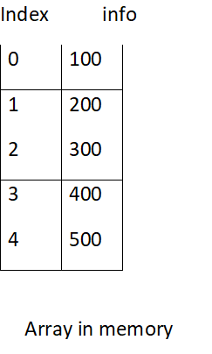
TRAVERSE IN LINEAR ARRAY
Suppose we have an array ‘M’ i:e collection of integer datatype in the computer memory, if we visit each and every element in ‘M’ then this visiting process is called traversing.

Slide 11
Lb=0
Ub=4
counter=Lb=0
Lineararr [counter]=100
counter=counter+1 = 0+1 = 1
Linear[Counter]=200
Example:
#include<stdio.h>
void traverse(int *,int,int);
void input(int *,int, int);
void traverse(int arr[], int lb, int ub)
{ int counter;

Slide 12
for(counter=lb; counter<=ub; counter++)
{
printf("\n element at position %d is %d", counter, arr [counter]);
} }
void input(int arr[],int lb, int ub)
{
int counter;
for(counter=lb; counter<=ub; counter++)
{
printf("\n input value for the %d", counter);
scanf("%d",&arr [counter]);
}
}

Slide 13
void main()
{
int a[100];
int lb1,ub1;
printf("lower limit of array");
scanf("%d", &lb1);
printf("\n upper limit");
scanf("%d", &ub1);
input(a, lb1,ub1);
traverse(a, lb1,ub1);
}

Slide 14
String and character array
A string is an array of character. A string is defined as any group of character enclosed between double quotation marks. The end of the string is marked with the single character ‘\0’,the NULL character, which has the ASCII value zero.
Syntax : <char><array name>[size];
Initialization of strings
String can be initialized at the time of declaration by using a for loop in the program. At the time of declaration, the string can be initialized array in the following manner.
char name[20]= “AMITY INTERNATIONAL”;
char name[20]={‘A’,’M’,’I’, …….,’N’,’A’,’L’,’\0’};
char name[]= “AMITY INTERNATIONAL”;
char name[]={‘A’,’M’,’I’, …….,’N’,’A’,’L’,’\0’};

Slide 15
//WAP enter a string and find length of string
#include <stdio.h>
void main()
{ int i=0, j=0;
char str[20];
printf(“enter string”);
gets(str);
while(str[i]!=’\0’)
{i++;
j++;
}
printf(“length of string is %d”,j);
}

Slide 16
//WAP enter two string and overwrite one over another
#include<stdio.h>
#include<conio.h>
void main()
{ int i,j;
char str1[10],str2[10];
printf("enter two string");
gets(str1);
gets(str2);
for(i=0;str1[i]!='\0';i++)
{str1[i]=str2[i];
}str1[i]='\0';
puts(str1);
getch(); }

Slide 17
// Program to change string from small to caps.
#include<stdio.h>
#include<conio.h>
#include<string.h>
void main()
{
char a[10];
int i;
clrscr();
printf("\n enter the string=");
scanf("%s",a);

Slide 18
i=0;
while(a[i]!='\0')
{if(a[i]>=97&&a[i]<=123)
{
a[i]=a[i]-32;
printf("%c", a[i]);
i++;
}
else
{
printf("%c", a[i]);
i++;
}}
getch();
}

Slide 19
// Input a string and show each character is vowel or not
#include<stdio.h>
#include<conio.h>
void main()
{
char ch[10];
int i=0;
clrscr();
printf("enter string ");
scanf("%s",ch);
}

Slide 20
while(ch[i]!='\0')
{
if(ch[i]=='a' || ch[i]=='i' || ch[i]== 'e' || ch[i]=='o' || ch[i]=='u')
printf("%c is vowel", ch[i]);
else
printf("%c is not vowel", ch[i]);
i++;
}

Slide 21
// WAP Enter a string and check whether it is palindrome or not
#include<stdio.h>
void main()
{
char str[20];
int i, len=0;
printf("enter sentence");
gets(str);
for(i=0;str[i]!='\0';i++);
len=i-1;
i=0;

Slide 22
while(str[i]==str[len])
{
i++;
len--;
if(len<i)
break;
}
if(len<i)
puts("palindrome");
else
puts("not palindrome");
}

Slide 23
Thank You

